Slide 1

Sprocket Central Pty Ltd
Data analytics approach
Abhishek Naik [Junior Consultant]

Slide 2
Agenda
Introduction
Data Exploration
Model Development
Interpretation

Slide 3
Introduction
Identify and Recommend High Value Customers
Problem Statement :
To boost business by analyzing their existing customer dataset to determine customer trends and behavior.
To recommend which of the 1000 new customers should be targeted to drive the most value for the organization.
Approach for Data Analysis :
Total profit by customer segment.
Past 3 years bike related purchase by customer segment.
RFM Score by customer segment.
On the Basis of above 3 analysis, we can find the variables responsible for increasing Profit, RFM Score. The same parameters will be filtered to get 50 most valued customers to target from new customer list.
The existing customers are also analyzed by RFM score to get the customer segmentation.

Slide 4
Data Exploration
Data Quality Assessment
 | Accuracy | Completeness | Consistency | Currency | Relevancy | validity | uniqueness
Customer Demographic |  | dob, job_title, job_industry, tenure columns, all null columns are removed |  |  | “U” in Gender is irrelevant,1843 Year of birth value is removed from DOB | Removed Deceased Customers
New Customer | for last name, dob, job_title, job_industry column |  | Replaced NSW, QLD, VIC to New South Wales, Queensland, Victoria in state column. |  | “U” in Gender column is removed, removed all unnamed columns, null columns, rank column, value column
Transactions | Product_first_sold_date column converted to Date format | Online order, order status, brand, product lines, product class, product size, standard cost columns
Customer Address |  | All columns with null values has been removed. | Replaced NSW, QLD, VIC to New South Wales, Queensland, Victoria in state column.

Slide 5
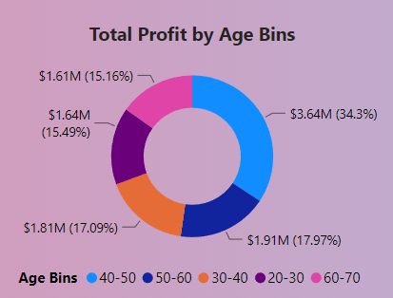
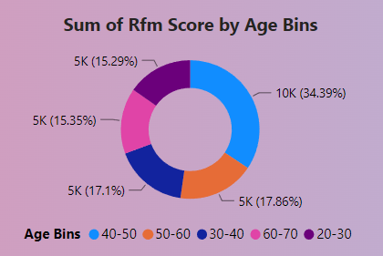
Data Exploration
Customer Age Group by Profit and Sum of
RFM Score
34.3 % of total profit came from 40-50 Age Group, 18% each from 50-60 and 30-40 Age group.
Around 70% of Total profit Came from these 3 age group itself, Therefore, 40-50, 50-60 and 30-40 Age group should be in focus.

Slide 6
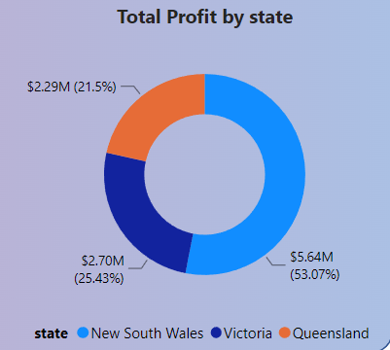
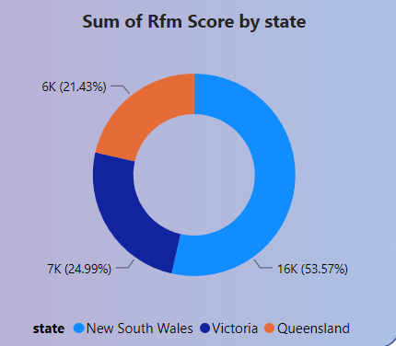
Data Exploration
Customer State by Profit and Sum of
RFM Score
53.07 % of total profit, RFM Score came from New South Wales state, 25% from Victoria and 21% from Queensland.
Around 53% of Total profit, RFM Score Came from New South Wales State itself, Therefore, New South Wales State should be in focus.

Slide 7
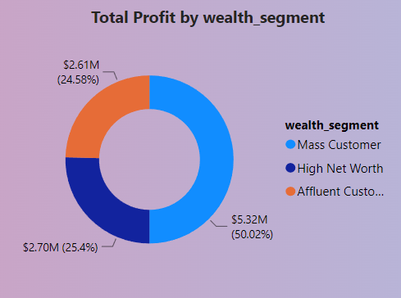
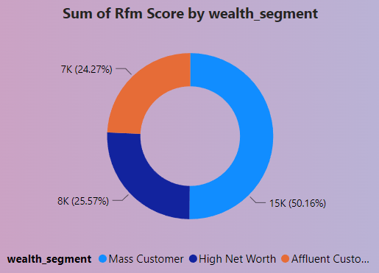
Data Exploration
Customer Wealth Segment by Profit and Sum of
RFM Score
50 % of total profit, RFM Score came from Mass Customers , 25% each came from High Net worth customers and Affluent Customers.
Around 50% Profit, RFM Score Came from Mass Customers itself, Therefore, Mass Customers should be in focus.

Slide 8
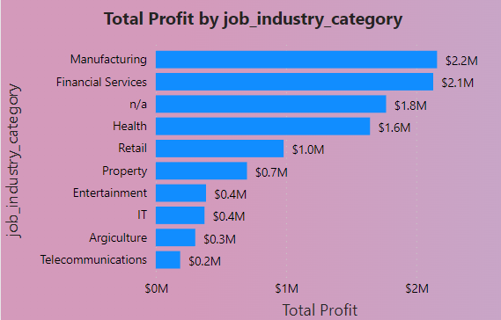
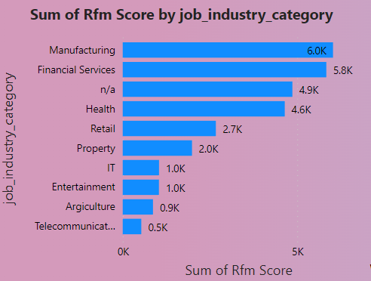
Data Exploration
Customer Job Industry Category by Profit and Sum of
RFM Score
24.47 % of total profit, Total RFM score came from Manufacturing Job industry, followed by 23% in Financial and 18% in Health.
Around 65% of Total profit Came from these 3 Job industry category itself, Therefore, Manufacturing, Financial and Health job industry should be in focus.

Slide 9
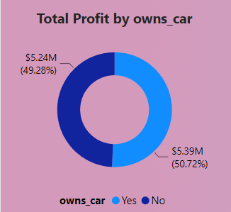
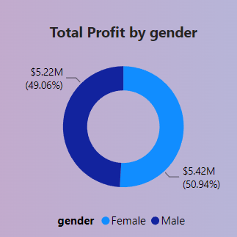
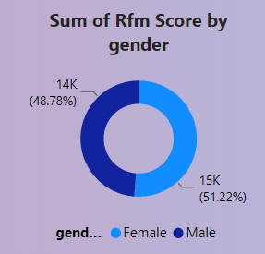
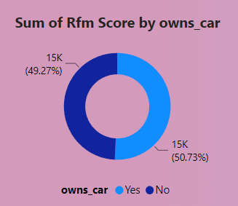
Data Exploration
Customer By Gender and Owns cars by Profit
and Sum of RFM Score.
We cannot find any major segments in customer gender and has car or not who does contribute to profit and RFM Score.
However, There is slight probability of females responsible for Higher Profit.

Slide 10
Data Modelling
RFM Analysis and Customer Classification
RFM (Recency, Frequency, Monetary value) analysis helps businesses gain insights into customer segments and tailor marketing strategies accordingly.
It can be used to identify valuable customers for targeted promotions, win back inactive customers, or personalize communication based on the customer's individual behavior.
Concatenation: creating segments, here we just concatenate (not add) individual RFM scores like strings and get labeled segments in return. The highest is 555 and the lowest is 111.
Sum of RFM Score: creating score, here we find the sum of the individual RFM scores indicating the customer's score. Highest 15 and lowest 3 and we can use this to create more human friendly labelled categories (Diamond, Gold, Silver, Bronze)

Slide 11
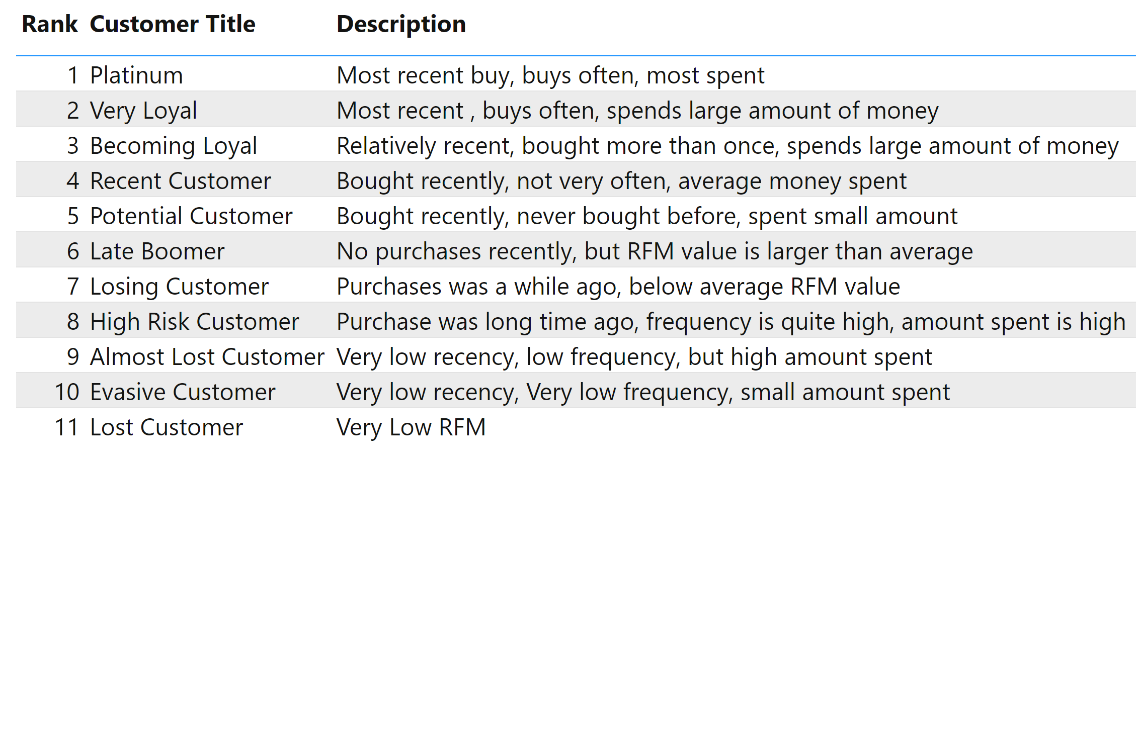
Model Development

Slide 12
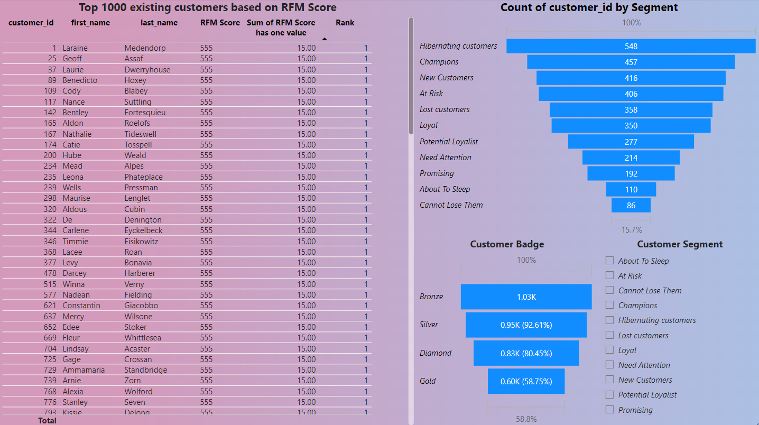
Model Development

Slide 13
Model Development
Based on the analysis, potential customers who have high value for the organization are:
Aged between 30 – 60.
Work in manufacturing, financial services, or health industry.
Classified as mass customer.
Live in New South Wales.
From these criteria above, we have 68 out of 1000 new customers who can be targeted for marketing strategies and potentially generate revenue for the company.

Slide 14
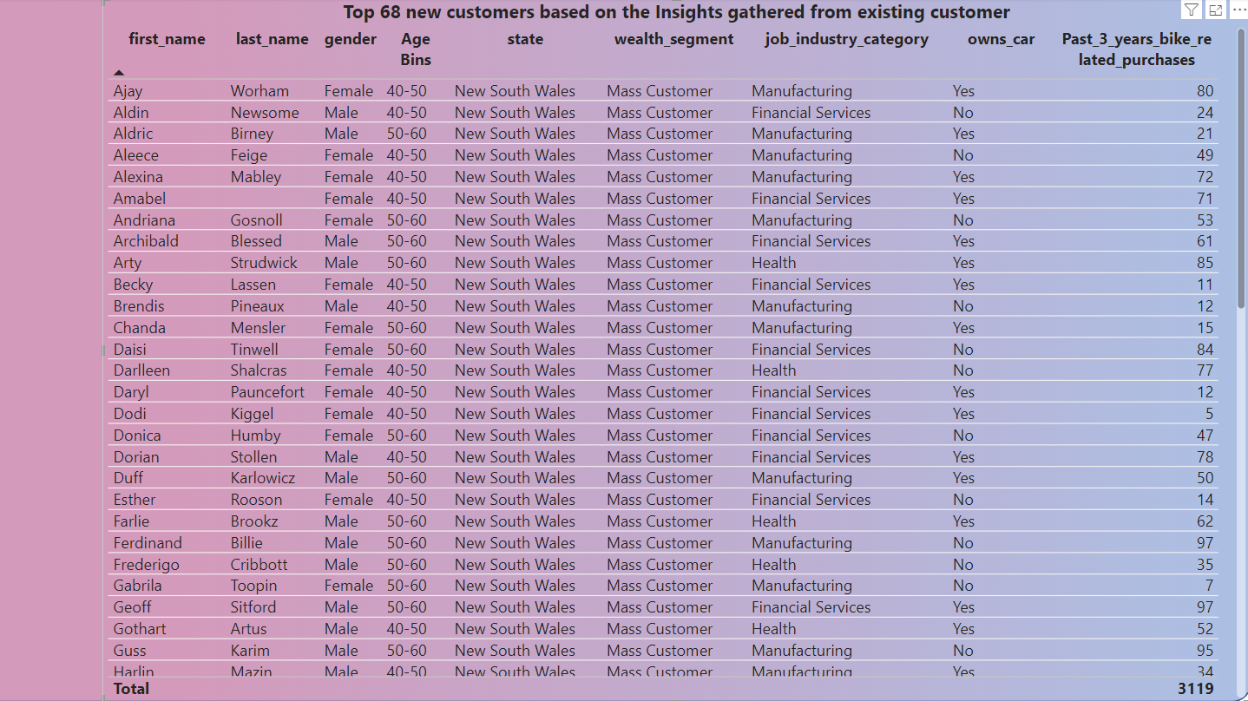
Model Interpretation

Slide 15
Thank you

